Slide 1




Algorithms
Alexander Graening, Brian Wang, Ziqi Wang, Wojciech Romaszkan
agraening, wangbri1, wangzq312, wromaszkan@ucla.edu
We thank historical contributors: Tianmu Li, Santadeep Pal, Dr. John Lee, Dr. Rani Ghaida. Dr. Abde Ali Kagalwalla and Dr. Yasmine Badr. Some slides materials are based on Introduction to Algorithms by Cormen et al. and Algorithms, 4th Edition by Robert Sedgewick and Kevin Wayne
Variability Expedition

Slide 2
What is an Algorithm?
An algorithm is a well-defined set of computational steps that takes an input and produces some output.
Algorithm
INPUT
(problem)
OUTPUT
(solution)
x
1
2
3
4
5
y = x²
y
1
4
9
16
25

Slide 3
Introductory Material
Link to materials:

Slide 4
Agenda (Morning)
What sort of problems are solved with algorithms?
Common Data Structures in Programing
Linked List, Queue, Stack, Tree, Graph
Search Algorithms
Sequential Search
Time Complexity and Space Complexity
Binary Search [Exercise ]
Sorting Algorithms
Bubble Sort [Exercise ]
Insertion Sort
Selection Sort
Quick Sort
Merge Sort [Optional Exercise ]

Slide 5
Agenda (Afternoon)
Potential office hour 1:15 pm to 2:45 pm
Graph
Graph Basics
Breadth-first Search [Exercise ]
Depth-first Search
A Brief Introduction to Other Algorithms
Algorithmic Techniques
Exercise, Q&A

Slide 6
Agenda (Morning)
What sort of problems are solved with algorithms?
Common Data Structures in Programing
Linked List, Queue, Stack, Tree, Graph
Search Algorithms
Sequential Search
Time Complexity and Space Complexity
Binary Search [Exercise ]
Sorting Algorithms
Bubble Sort [Exercise ]
Insertion Sort
Selection Sort
Quick Sort
Merge Sort [Optional Exercise ]

Slide 7
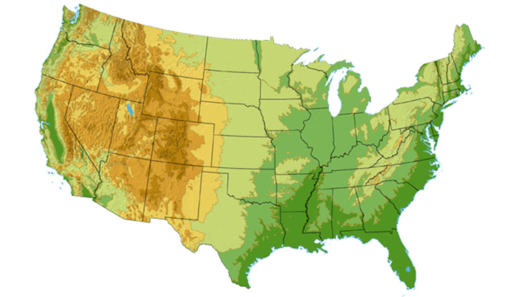









What sort of problems are solved with algorithms?
DS3 (45 Mbps)
OC3 (155 Mbps)
OC12 (622 Mbps)
OC48 (2.4 Gbps)
Seattle
Tacoma
Stockton
Cheyenne
Chicago
New York
Pennsauken
Relay
San Jose
Kansas City
Roachdale
Wash. DC
Anaheim
Atlanta
Fort Worth
Orlando
Internet - Manage and manipulate data
E.g., (1) search engines, (2) finding good routes on which data will travel

Slide 8
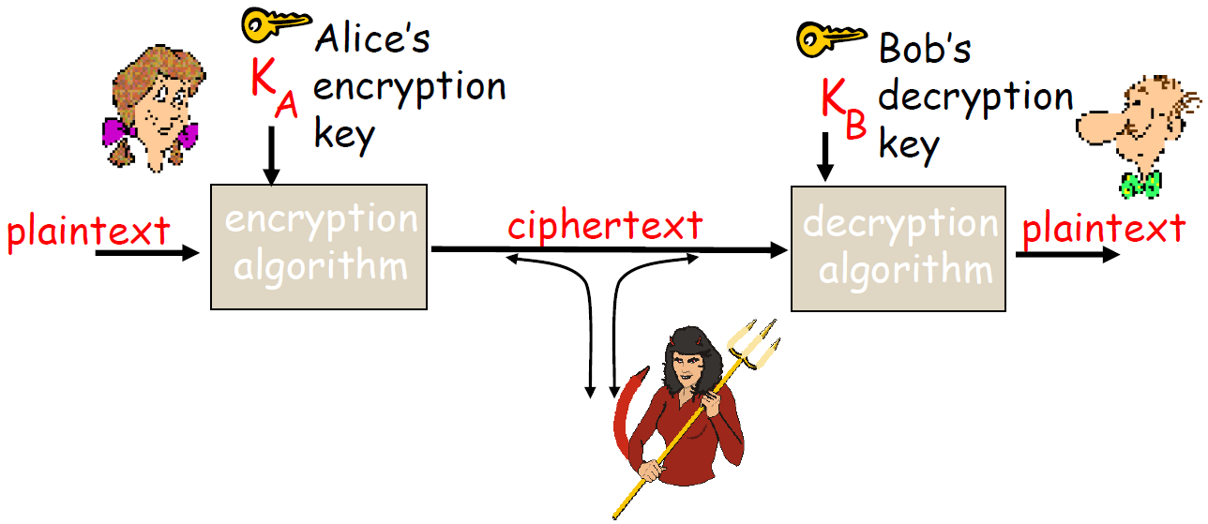
What sort of problems are solved with algorithms?
ujner@ si emosewa¡
Algorithms are awesome!
Algorithms are awesome!
Data security – cryptography
Encryption algorithm
→ computational steps to transform plaintext to ciphertext
Decryption algorithm
→ computational steps to transform ciphertext back to plaintext

Slide 9
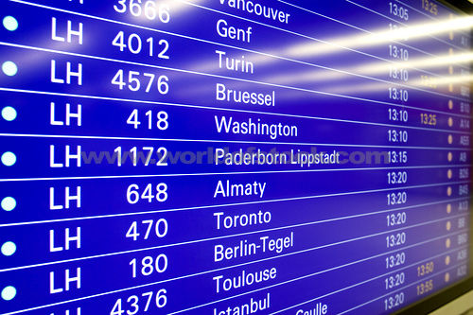
What sort of problems are solved with algorithms?
Scheduling problems
Example: Flight scheduling
Crew preferences
Airplane types
Weather
Fuel Costs
Delays
From http://www.worldofstock.com/slides/TRA2599.jpg

Slide 10
Agenda (Morning)
What sort of problems are solved with algorithms?
Common Data Structures in Programing
Linked List, Queue, Stack, Tree, Graph
Search Algorithms
Sequential Search
Time Complexity and Space Complexity
Binary Search [Exercise ]
Sorting Algorithms
Bubble Sort [Exercise ]
Insertion Sort
Selection Sort
Quick Sort
Merge Sort [Optional Exercise ]

Slide 11
Why are Data Structures Important?
Different data structures are good for different problems or different algorithms.
Characteristics of an ideal data structure
Fast to access the data you need
Fast to add or remove items
Arrays
Linked lists and variants
Graphs and trees

Slide 12

The Simplest Data Structure
Array (This is the simplest structure.)
- Keep track of the starting point of the array in memory.
- To access item 4, just count over from the starting point.
- This works for checking what is stored in the array or changing the value.
- What happens if I want to make the array bigger?
- What if I want to find an entry with a specific value? (Check all items.)
- Arrays are an excellent structure if you know how many items you want to store and you know where they will be.
MyArray
…
 |  |  | 6 | 1 | 4 | 3 | 4 | 23 | 1 | 15
…
Photo.png
WordDocument.docx
Address in memory
MyArray
…
 |  |  | 6 | 1 | 4 | 3 | 4 | 23 | 1 | 15
…
 |  |  | 0 | 1 | 2 | 3 | 4 | 5 | 6 | 7
Photo.png
WordDocument.docx
WordDocument.docx
MyArray
…
 |  |  | 6 | 1 | 4 | 3 | 4 | 23 | 1 | 15 | 8
…
Photo.png
WordDocument.docx

Slide 13
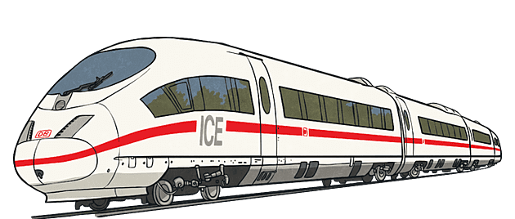

Linked Lists
Head
6
1
4
3
4
23
1
15
8
NULL
Unlike arrays, this data structure makes it easy to increase the number of items you are storing.
NULL
6
4
3
1
4
23
1
15
NULL
8
NULL

Slide 14
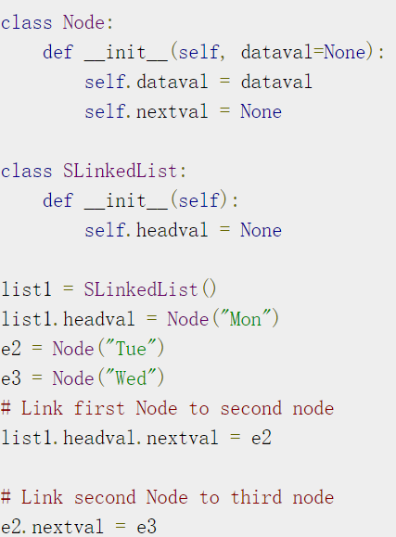
Linked List Implementation
Mon
Tue
Wed
Mon
Tue
Wed
Mon
Tue
Wed

Slide 15

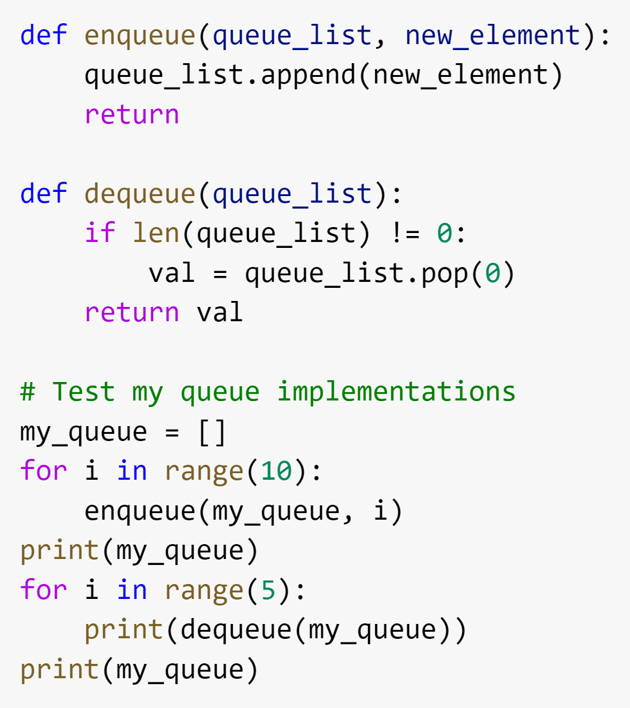
Waiting in a Queue
A First In First Out List
What will the output be?
Figure source: https://en.wikipedia.org/wiki/Queue_(abstract_data_type)

Slide 16
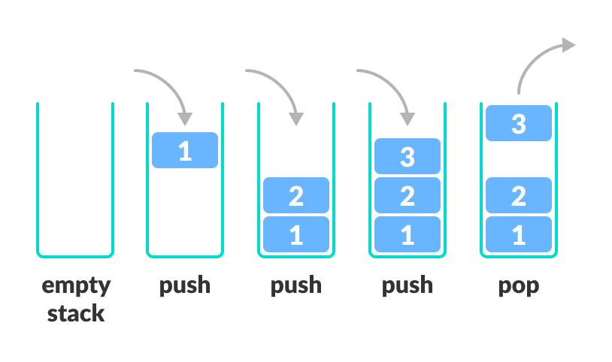
Stacks
A Last In First Out (LIFO) list
The only difference is you remove the most recent element.
Exercise: How to convert the code for a queue into code for a stack?
Figure source: https://www.programiz.com/dsa/stack

Slide 17
Exercise
How would you convert the code for a queue into code for a stack?
Queue
Stack

Slide 18
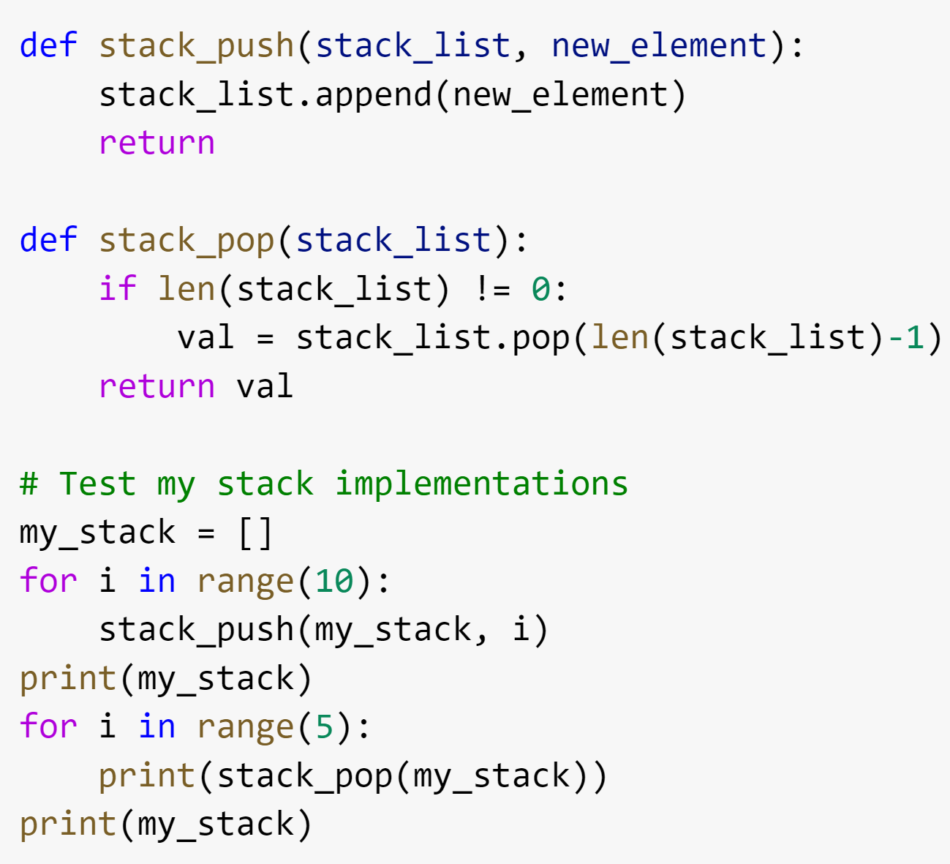
Solution
How would you convert the code for a queue into code for a stack?
Queue
Stack

Slide 19
Graphs
Structure of nodes and connections between those nodes
There is a large family of algorithms for handling graphs. We will talk a little bit about graph algorithms later in this module and the 5th module is dedicated to graphs.
A
B
JFK
C
LAX
LAX
STL
D
E
HNL
DFW
FTL

Slide 20
Trees
Hierarchical tree structure, with a root node and child nodes that may form their own subtrees.
This is represented as a set of linked nodes.
Each node other than the root node must have exactly one parent node.
A
B
C
D
E
F
G
H
I
J
K
L
M

Slide 21
Binary Search Trees
Special type of tree with no more than two child nodes per parent.
The left child must be less than or equal to the parent.
The right child must be greater than the parent.
How would I determine if the value 7 exists in the binary search tree?
4
3
15
1
4
6
23
1

Slide 22
Summary of Data Structures
What we covered:
Array
Linked Lists
Queue (First In First Out)
Stack (Last In First Out)
Graph
Tree
Binary Search Tree
There are many other structures that we did not cover…
Heap
Hash
Strings
etc.
Many programming languages have libraries to handle the specific implementation details for common data structures.

Slide 23
Agenda (Morning)
What sort of problems are solved with algorithms?
Common Data Structures in Programing
Linked List, Queue, Stack, Tree, Graph
Search Algorithms
Sequential Search
Time Complexity and Space Complexity
Binary Search [Exercise ]
Sorting Algorithms
Bubble Sort [Exercise ]
Insertion Sort
Selection Sort
Quick Sort
Merge Sort [Optional Exercise ]

Slide 24

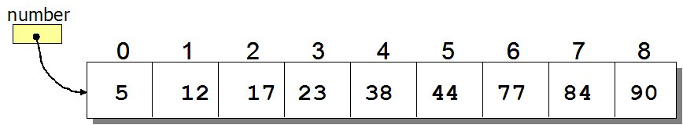
Search Algorithms
How to search for an element in a list?
Sequential search: Go through each element and check if it is the required element
Best case?
Worst case?
Source: http://www.spinachandyoga.com/how-to-deal-with-a-long-to-do-list-with-zen/
Source: http://www.csit.parkland.edu/~mbrandyberry/CS1Java/Lessons/Lesson27/BinarySearch.htm

Slide 25
Evaluating Algorithms
How do we know whether one algorithm is better than another?
for i = 0 to n
a = 1
for i = 0 to n
for j = 0 to n
a = 1
Which one runs faster?
Notes:
One way we determine whether an algorithm is better than another is by seeing how fast the algorithm runs.
Note to self – ask them which one runs faster, maybe set up a poll

Slide 26
Time-Complexity: Upper Bound O-notation
for i = 0 to n
a = 1
for i = 0 to n
for j = 0 to n
a = 1
O(n)
O(n²)
Algorithm X executes in 10n² + n / 3.7 + 22 steps → O(n²)
Algorithm Y executes in 100n log n + 14n + 22 steps → O(n log n)
Which algorithm runs faster?
Algorithm Y
Notes:
Explain Big O notation – worst case running time of an algorithm. There are other ways of measuring time complexity, but we don't cover them here
Explain how time complexity is dominated by the largest term, which simplifies time complexity estimation

Slide 27
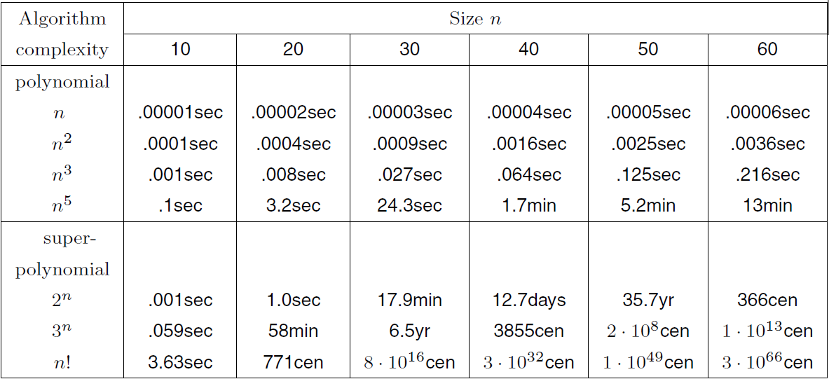
Running Time Comparison

Slide 28
Running Time Comparison

Slide 29
Running Time Comparison

Slide 30
Running Time Comparison
Good
Bad!
Notes:
Note – time complexity lets us characterize of how fast an algorithm can run, with the larger time complexity being worse for running time.

Slide 31
Search Algorithms
How to search for an element x in a list?
Sequential search: Go through each element and check if it is the the required element
Best case?
Worst case?
What if the list is sorted?
Can we do better?
YES
BINARY SEARCH
Source: http://www.spinachandyoga.com/how-to-deal-with-a-long-to-do-list-with-zen/

Slide 32
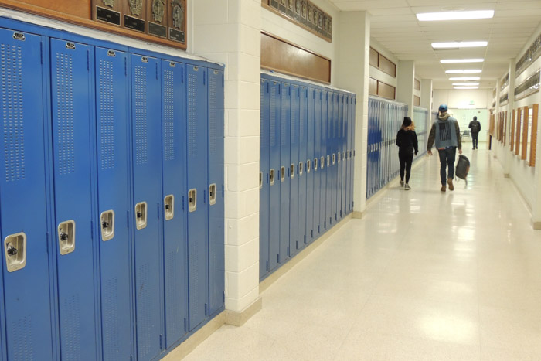
Binary Search Problem
Problem: You are looking for your school locker, which is number 151. At one end of the hallway, the lockers start at 100, and they end on 199 on the other side of the hallway.
What is the best way to search for your locker?
Notes:
You should also set up a poll question for this.

Slide 33
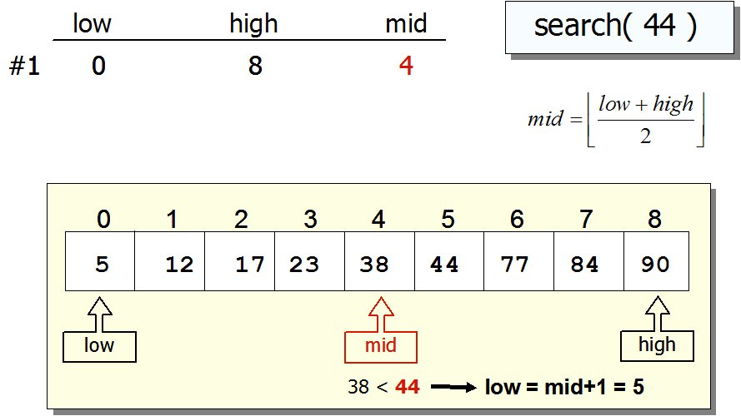
Search Algorithms: Binary Search
If list is sorted:
Split list into two halves. If x is greater than element in the middle, then discard the left half. Otherwise discard the right half. Repeat until you find x.
Source: http://www.csit.parkland.edu/~mbrandyberry/CS1Java/Lessons/Lesson27/BinarySearch.htm

Slide 34
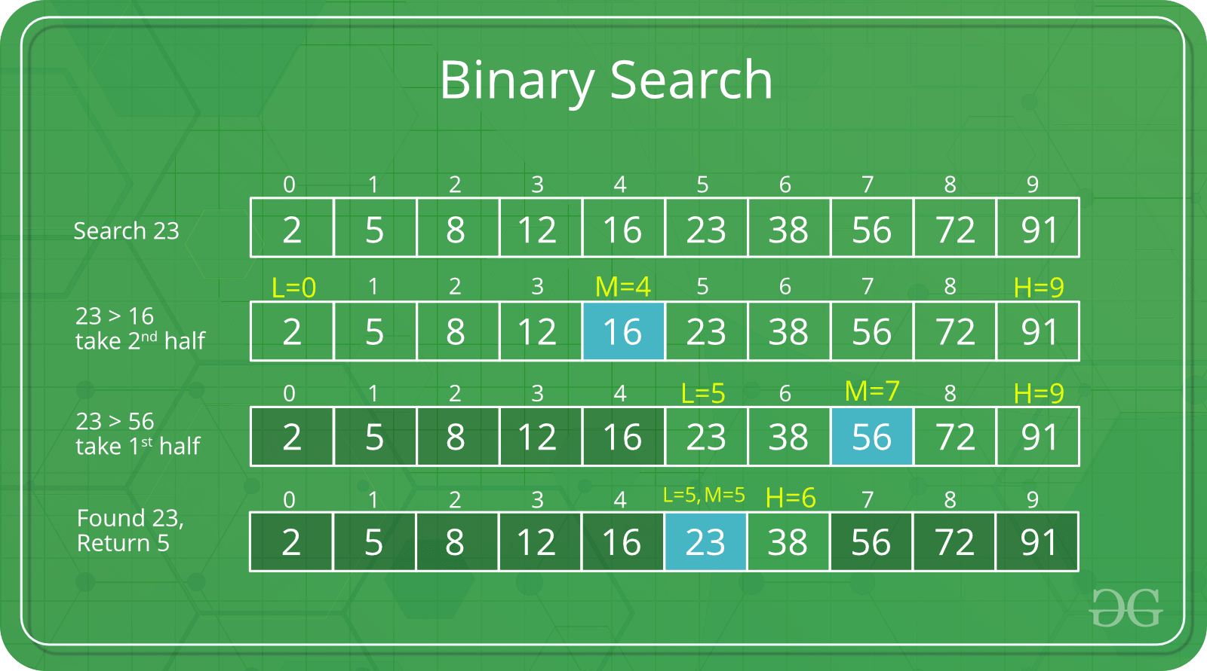
Search Algorithms: Binary Search
If list is sorted:
Split list into two halves. If x is greater than element in the middle, then discard the left half. Otherwise discard the right half. Repeat until you find x.
Sourcehttps://www.geeksforgeeks.org/binary-search/

Slide 35
Search Algorithms: Binary Search
If list is sorted:
Split list into two halves. If x is greater than element in the middle, then discard the left half. Otherwise discard the right half. Repeat until you find x.
Sourcehttps://www.geeksforgeeks.org/binary-search/

Slide 36
Search Algorithms: Binary Search
If list is sorted:
Split list into two halves. If x is greater than element in the middle, then discard the left half. Otherwise discard the right half. Repeat until you find x.
Sourcehttps://www.geeksforgeeks.org/binary-search/

Slide 37
Search Algorithms: Binary Search
If list is sorted:
Split list into two halves. If x is greater than element in the middle, then discard the left half. Otherwise discard the right half. Repeat until you find x.
Sourcehttps://www.geeksforgeeks.org/binary-search/

Slide 38
Agenda (Morning)
What sort of problems are solved with algorithms?
Common Data Structures in Programing
Linked List, Queue, Stack, Tree, Graph
Search Algorithms
Sequential Search
Time Complexity and Space Complexity
Binary Search [Exercise ]
Sorting Algorithms
Bubble Sort [Exercise ]
Insertion Sort
Selection Sort
Quick Sort
Merge Sort [Optional Exercise ]

Slide 39
Sorting Algorithms
Sorting algorithm is an algorithm that puts elements of a list in a certain order
Sorting is a fundamental operation in computer science and algorithms
Many algorithms use it as an intermediate step
There are several sorting algorithms, differing in their efficiency.

Slide 40
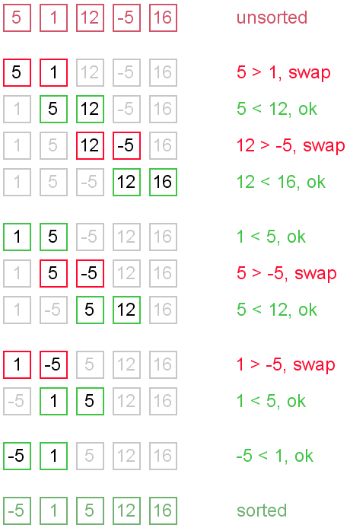

Bubble Sort
Go through the list:
If the next element is smaller:
SWAP!

Slide 41
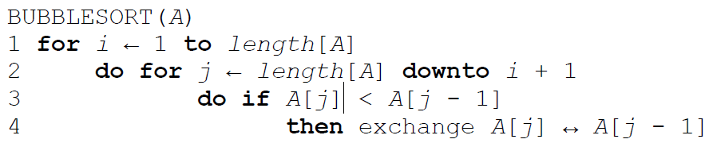
Bubble Sort

Slide 42
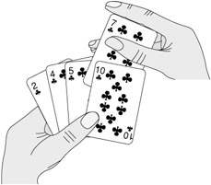
Insertion Sort
Start with empty left hand
Pick one card at a time
Insert it into the correct position in left hand
To find correct position, compare it with each of the cards already in hand

Slide 43
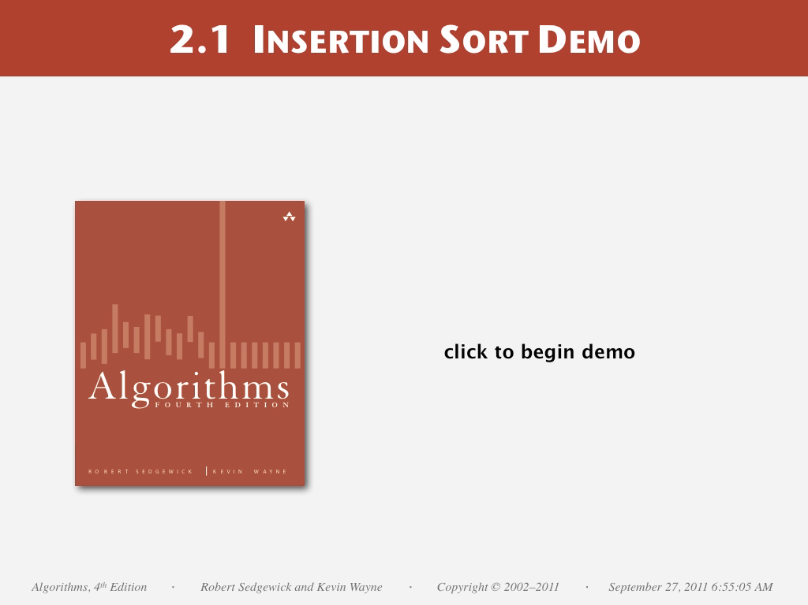

Slide 44
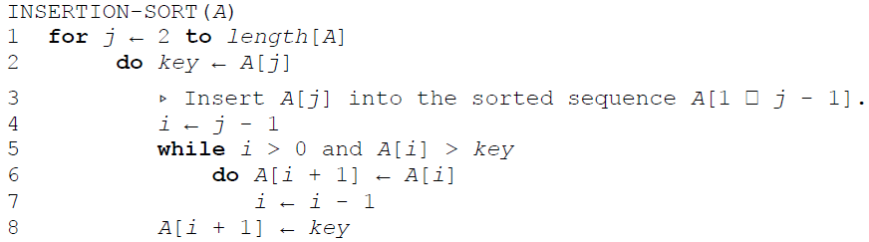
Insertion Sort

Slide 45
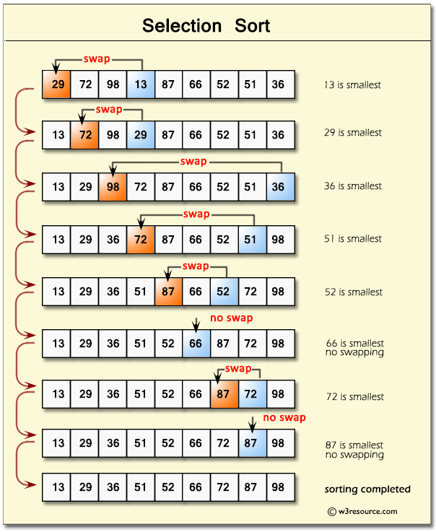
Selection Sort
In iteration i, find index of the smallest entry in unsorted part of the list
Swap a[i] and a[min]
i ← i + 1
Notes:
Bubble sort
Insertion

Slide 46


Slide 47
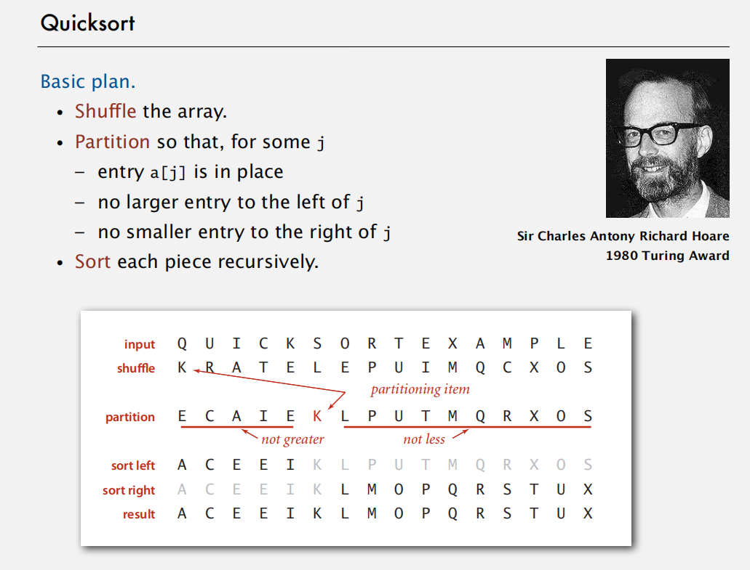
Quick Sort

Slide 48
Quick Sort Partitioning Demo
23DemoPartitioning.pdf

Slide 49
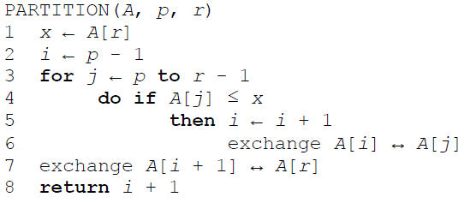
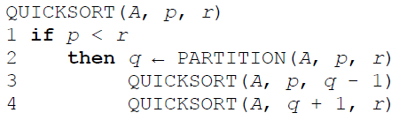
Quicksort

Slide 50
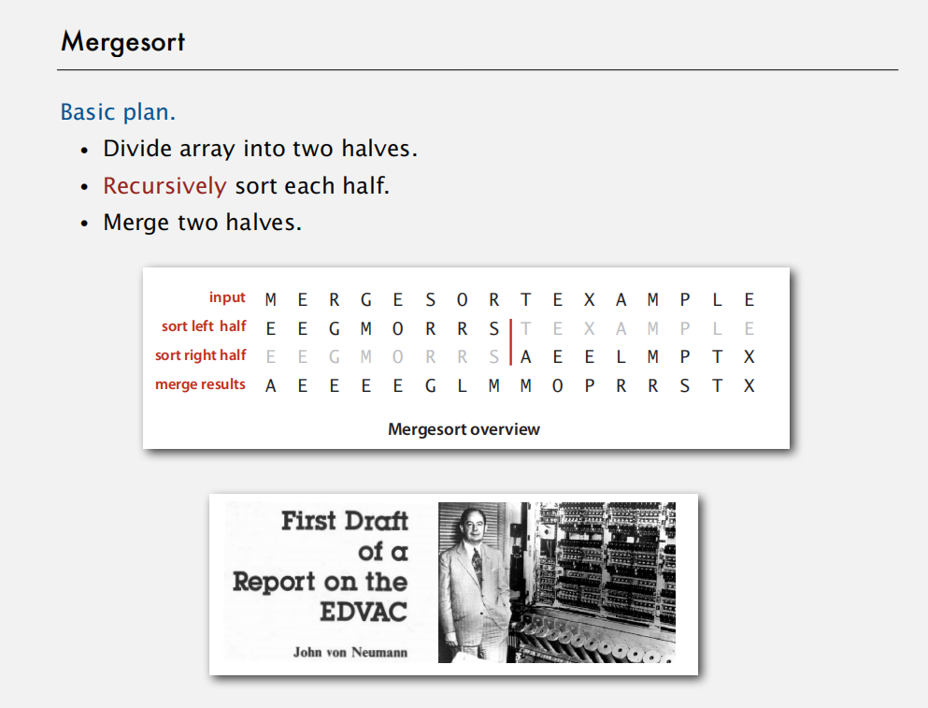

Slide 51
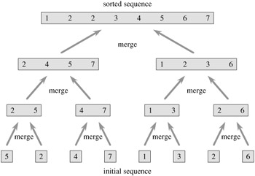
Merge Sort
Divide and conquer algorithm
Recursive algorithm
Split the list
Apply merge sort to the smaller list
After the smaller lists are collected: MERGE
(Note that each of the sublists is already sorted)

Slide 52
Exercise: Bubble sort and comparison to Python sorting algorithm
Binary Search:
https://leetcode.com/problems/binary-search/
Bubble Sort:
Optional: Merge Sort
https://leetcode.com/problems/sort-an-array/

Slide 53
Time for some exercise and discission.

